Slide 1
An introduction to
Marie Skłodowska-Curie Actions (MSCA)
Doctoral Networks 2025
UKRO MSCA Webinar Series
Dr Anja Berndt & Ms Raquel Meco Melguizo
UK MSCA NCPs
mariecurie-uk@ukro.ac.uk
10 July 2025
Notes:
Eugen Stulz is an Associate Professor in Bioorganic and Materials Chemistry at the University of Southampton. Eugen was awarded two DNs in the last round, one of them as a coordinator.

Slide 2



Agenda
1. Welcome
Introduction to UKRO and the UK's Relationship with the EU
2. MSCA Doctoral Networks 2025
Scheme overview, submission and evaluation process, and practical considerations for proposal development.
3. Guest speaker
Prof. Eugen Stulz, University of Southampton, experience in applying and successfully securing two MSCA DN awards.
4. Question and Answer
Notes:
All participants will be muted for the duration of the webinar.
The chat function is disabled, so please use the Q&A function to submit questions.
The session is being recorded.

Slide 3
Introduction to UKRO &​ the UK’s Relationship with the EU​
Participation in Horizon Europe

Slide 4

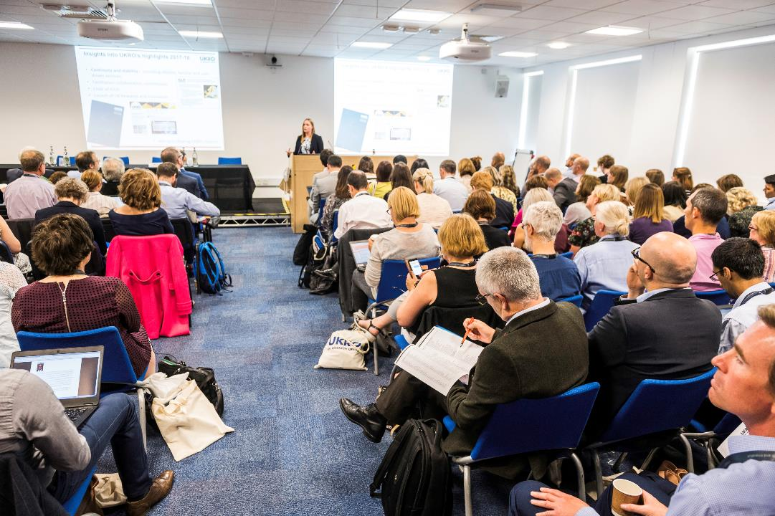
About UKRO
We support UK based organisations involved in EU R&I
Our Mission: Maximise UK participation in Horizon Europe
UKRO Portal
  dedicated news articles, events and factsheets to support participation
  alerts to upcoming opportunities and call updates
UK National Contact Point for
  European Research Council
  Marie Sklodowska-Curie Actions programmes
  Widening Participation
  European Cooperation in Science and Technology (COST)
  New European Bauhaus
We are part of UKRI’s International team
Notes:
Maximise the UK’s participation in Horizon Europe, which is the EU’s key research and innovation programme.
We are also appointed by the UK government to give free, impartial advice on:

Slide 5


Horizon Europe: UK Participation
The UK’s association to Horizon Europe and Copernicus took effect on 1 January 2024.
This means UK entities can participate in/coordinate projects and receive funding from Horizon Europe, with the exception of the EIC Accelerator Investment Fund.
As of 2025 even more opportunities will be available to UK researchers & innovators.
The UKRO website provides information on upcoming European funding opportunities.

Slide 6
What Does this Mean for Marie Skłodowska-Curie Actions?
In MSCA Doctoral Networks, UK based organisations
can:
Participate as beneficiaries
Coordinate projects
Recruit doctoral candidates
Can award PhDs
Host secondments
Recruited doctoral candidates count toward the total number of person-months
https://marie-sklodowska-curie-actions.ec.europa.eu/news/horizon-europe-uk-participation

Slide 7
MSCA

Slide 8
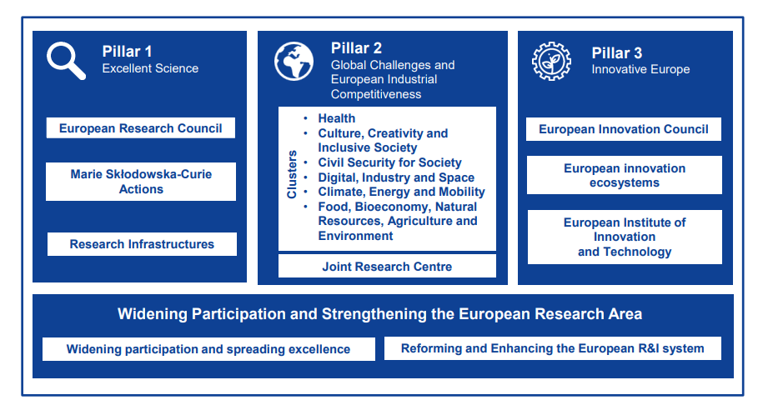
MSCA in Horizon Europe
Excellent Science: reinforcing and extending the excellence of the European Union’s scientific base
Equipping researchers
with new knowledge
and skills through mobility
and training
Budget = €6.6billion
Notes:
Horizon Europe is the EU’s flagship programme for research and innovation, running from 2021-2027 and with a budget of €95.5 billion.
Horizon Europe consists of three main pillars – reflecting the current R&I priorities of the Union – and an additional transversal element, focused on widening participation and strengthening the European Research Area:
Pillar 1 – largely fellowships schemes, which are bottom-up funding op. The MSCA supports the mobility of researchers.
Pillar 2 – collaborative funding ops around clusters/thematic areas. These are more top-down and impact driven.
Pillar 3 – funding for innovation, the biggest part of it is the European Innovation Council.
For the purpose of this information webinar, I’m going to focus on MSCA within Pillar 1.

Slide 9
MSCA Figures from Horizon 2020 (2014-2020)
+65,000
Researchers, including 25,000 PhD candidates
42%
Female researchers
+1,000
Doctoral programmes
Over 5,000
Companies supported
12 Nobel Prizes
winners backed by or involved in MSCA
~40% of researchers from outside the EU
Notes:
To put the scheme into context, here there are some figures of the MSCA schemes in H2020.
Under Horizon 2020, the UK was the best performing country in MSCA, representing around 20% of all participation in the programme

Slide 10
MSC Actions
Doctoral Networks
Doctoral programmes in and outside academia, inc. joint & industrial doctorates
Total budget 2025: €597.80 million
Opening call: 28/05/2025
Deadline: 25/11/2025
Postdoctoral Fellowships
Support to excellent postdoctoral researchers
Total budget 2025: €404.29 million
Opening call: 08/05/2025
Deadline: 10/09/2025
Staff Exchanges
Support for research and innovation staff exchanges
Total budget 2025: €97.71 million
Opening call: 27/03/2025
Deadline: 08/10/2025
COFUND
Co-funding doctoral and postdoctoral programmes
Total budget 2025: €128 million
Opening call: 23/01/2025
Deadline: CLOSED
MSCA and Citizens
Public outreach events aiming to bring research and researchers closer to the public
Total budget 2025: €16.25 million
Opening call: 17/06/2025
Deadline: 22/10/2025

Slide 11






MSCA Key Features
Researchers’ training, skills and career development (all stage of career)
Excellent research in all domains (bottom-up approach)
International, Intersectoral & Interdisciplinary mobility
(the three ‘I’)
Attractive working and employment conditions
Structuring impact on organisations through excellent programmes
Strong collaboration with industry and SMEs

Slide 12
MSCA Doctoral Networks
HORIZON-MSCA-2025-DN-01-01

Slide 13


MSCA Doctoral Network
A collaborative research project implemented through individual PhD projects – one consortium!
The consortia should be multidisciplinary, multisectoral and international.
The aim is to train creative, entrepreneurial, innovative and resilient doctoral candidates, while undertaking a shared research project.
PhD project 1
recruit
Beneficiary
in HE AC
Beneficiary in EU MS
Beneficiary
in HE AC
recruit
recruit
PhD projects 2 and 3
PhD projects 4 and 5

Slide 14
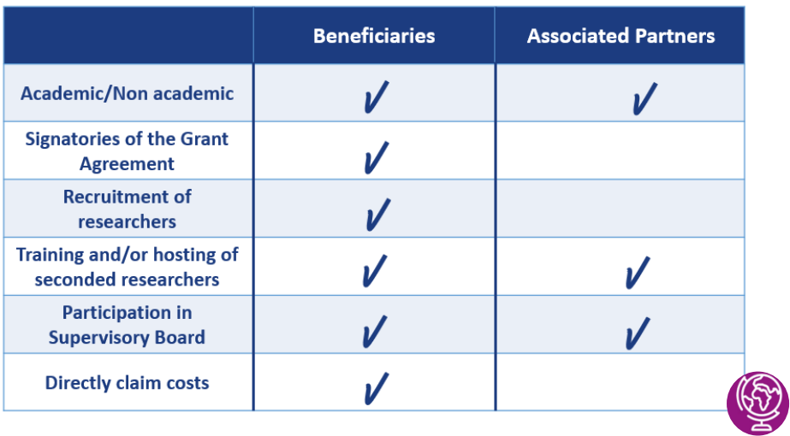


MSCA DN - Participant types
Collaborative Research Project
recruit
Beneficiary
in AC
Beneficiary in EU MS
Beneficiary
in AC
recruit
recruit
Secondment A
Secondment B
Associated Partner
(anywhere in the world, any sector)

Slide 15
MSCA DN – the Consortium
Min 3 beneficiaries in EU MS/ACs - one of which must be from an EU MS
Only beneficiaries can recruit PhD students.
Each beneficiary must recruit, host at their premises and supervise at least 1 researcher.
Vacancies on EURAXESS
- My EURAXESS | EURAXESS (europa.eu)
Not more than 40% of the EU contribution may be allocated to beneficiaries in the same country or to a single international organisation.
MSCA Work Programme 2023-2025
Notes:
At least 3 independent legal entities:
Each established in a different EU Member States or Horizon Europe Associated Country
Minimum of 1 beneficiary from an EU Member State
No minimum / maximum number of Associated Partners

Slide 16
Three Types of Networks
Doctoral Network (STANDARD DN)
Joint Doctorates
(DN-JD)
Innovative doctoral training in academia and/or industry
Project duration: max. 48 months
Secondments: worldwide, up to 1/3 of the fellowship duration.
Industrial Doctorates (DN-ID)
Doctoral training in academia and industry.
Project duration: max. 48 months
No limit on secondment duration
Integrated doctoral training leading to joint, double or multiple doctoral degrees.
Enrolment in joint/double or multiple PhD (at least 1 EU MS/AC)
PhD duration: min. 3/ max. 36 months
Joint supervision between academic and non-academic organisations.
PhD duration: min. 3/max. 36 months
Min. 50% of fellowship duration in the non- academic sector
Joint admission, selection, training and supervision by the PhD awarding institutions
Project duration: max. 60 months
PhD duration: min. 3/max. 48 months
No limit on secondment duration
Non-academic sector as beneficiary or associated partner
Notes:
Joint Doctorates (DN-JD) should lead to the delivery of joint, double or multiple doctoral degrees recognised in at least one EU Member State (MS) or Horizon Europe Associated Country (AC) (as opposed to minimum two under DN 2023).

Slide 17

“Training through Research” examples
Transferable skills training
Communication
Research management
Societal outreach
Entrepreneurship
IPR, Open Science
Gender mainstreaming
Networking events
Conferences
Workshops
Roundtables
Webinars
Dissemination activities
Social media
Final conference
Public engagement
Exposure to the non-academic sector
Secondments
Placements
Industry visits
Research and Innovation Projects

Slide 18
A Successful MSCA Doctoral Network ….
…is more than just a research project – needs to include training aspects!
Advanced/
Additional Research Skills
Core Research Skills
Transferable Skills
Local training
at the host organisation where the DC will work
Network-wide training
e.g. workshops, summer schools, training weeks
Secondment programme

Slide 19
Doctoral Candidate (DC) - Eligibility Criteria
Often referred to as Early-Stage Researcher (ESR)
Supported researchers must be a doctoral candidate (i.e. not already in possession of a doctoral degree at the date of the recruitment).
ESR must be recruited and enrolled in a doctoral programme leading to the award of a doctoral degree in at least one EU Member State or Horizon Europe Associated Country
Industrial Doctorates - ESR must spend minimum 50% of fellowship at non-academic partner
Recruited researchers can be of any nationality
Recruited researchers must comply with the mobility rule
Mobility Rule
They must not have resided or carried out their main activity (work, studies, etc.) in the country of the recruiting beneficiary for more than 12 months in the 36 months immediately before their recruitment date.
Compulsory national service, short stays such as holidays, and time spent by the researcher as part of a procedure for obtaining refugee status under the Geneva Convention are not taken into account.
Notes:
The period of residence starts from the day they arrived in the country before the start date of the employment contract (e.g. to look for an apartment) and ends the day they left (e.g. dates of flight/ train tickets, visa, etc.).

Slide 20
Doctoral Networks - Secondments
Secondments can take place anywhere in the world.
“Training through Research”
Highly recommended to supplement and complement the training of DCs!
During their secondment, researchers receive supervision and training at the premises of the receiving beneficiary or partner organisation.
Must be detailed in the proposals – please refer to proposal template:
  Percentage of time spent at secondment hosting institutions
  Goals of secondments
Secondment costs
  Costs for secondments 6 months or less covered by institutional costs (at least travel, visa and accommodation).
  Longer secondments can also be covered in this way, if necessary.
Secondments can take place in the academic and non-academic sectors.
Secondment duration:
Standard MSCA DN:
-Maximum 1/3 fellowship duration
MSCA DN-ID, MSCA-JD:
No limitation on secondment duration

Slide 21
Call Timeline
All information for a successful application can be found on the MSCA 2025 DN Call Webpage
Action | Date (tentative)
Call opening | 28 May 2025
Deadline for Submission | 25 November 2025, 17:00 CET.
Notification of applicants if their proposal has been successful | ~April 2026
Indicative Date for Signing the Grant Agreement | ~July 2026
Project Start | ~September 2026
Submit Early, Submit Often!
Commission collects proposals at Deadline

Slide 22
The Budget
How the funding works
HORIZON-MSCA-2025-DN-01-01

Slide 23

Monthly Unit Costs
Maximum number of person-months you can request = 540
Monthly EC contributions per recruited Doctoral Candidate
(“Person-month”)
Contributions for recruited researchers Per person-month |  |  |  |  | Institutional unit contributions Per person-month
Living Allowance | Mobility Allowance | Family Allowance* | Long-term Leave Allowance* | Special Needs Allowance* | Research, training and networking contribution | Management and indirect contribution
EUR 4010 | EUR 710 | EUR 660 | EUR 4720 x % covered by the beneficiary | Requested unit x (1/number of months) | EUR 1 600 | EUR 1 200
* Only if applicable.
Contributions for the recruited researcher
Research & training costs
Costs for the host institution
Notes:
Fully based on unit costs
1 unit = 1 month of eligible DC
Total costs = costs per unit x number of units
100% Reimbursement rate for eligible beneficiaries
Different cost categories:
Researcher’s cost
Institutional costs (research, training, networking + management)

Slide 24
ESR Unit Costs
Contributions for recruited researchers per person-month |  |  |  |  | Institutional unit contributions Per person-month
Living Allowance* | Mobility Allowance | Family Allowance** | Long-term Leave Allowance** | Special Needs Allowance** | Research, training and networking contribution | Management and indirect contribution
EUR 4010 | EUR 710 | EUR 660 | EUR 4 000x % covered by the beneficiary | Requested unit x (1/number of months) | EUR 1 600 | EUR 1 200
*multiplied by the country correction coefficient (CCC)
** can be applied at any time (as and when needed)
UK CCC = 141,7%
Researcher Unit Costs (ESR allowances)
Living allowance subject to Country Correction Coefficient
- 141,7%% for the UK. EC contribution = gross salary
costs of the researcher
If paid out together as salary, the living allowance, mobility allowance and (if applicable) family allowance is subject to compulsory deductions under national law (e.g. employer
and employee social security contributions; direct taxes...)
Institutions are strongly advised to explain how the salary will be calculated
UK institutions may apply a conservative exchange rate
  Protects the institution and fellow from fluctuations
  This usually leads to an underpayment, corrected at the end of the fellowship with a lump sum payment

Slide 25


ESR Unit Costs
Contributions for recruited researchers per person-month |  |  |  |  | Institutional unit contributions Per person-month
Living Allowance* | Mobility Allowance | Family Allowance** | Long-term Leave Allowance** | Special Needs Allowance** | Research, training and networking contribution n | Management and indirect contribution
EUR 4010 | EUR 600 | EUR 660 | EUR 4 000x % covered by the beneficiary | Requested unit x (1/number of months) | EUR 1 600 | EUR 1 200
*multiplied by the country correction coefficient (CCC)
UK CCC = 141,7%
​
Industrial Doctoral and Joint Doctorates:
CCC needs to be considered when calculating the requested ESR unit costs for the living allowance
ESR recruited separately by each beneficiary for a specific duration
When calculating the requested award,
different country correction
coefficients for each stay must be
used
ESR employed 100% by a beneficiary and sent to other beneficiaries or partner organisations ​
When calculating the requested award,
only one country correction coefficient​ must be used

Slide 26
ESR Unit Costs
Contributions for recruited researchers per person-month |  |  |  |  | Institutional unit contributions Per person-month
Living Allowance* | Mobility Allowance | Family Allowance** | Long-term Leave Allowance** | Special Needs Allowance** | Research, training and networking contribution | Management and indirect contribution
EUR 3 400 | EUR 710 | EUR 660 | EUR 4 000x % covered by the beneficiary | Requested unit x (1/number of months) | EUR 1 600 | EUR 1 200
** can be applied at any time (as and when needed)
Mobility Allowance
covers costs related to the researcher’s mobility
(e.g. relating to travel and accommodation).
It covers the private costs of the researcher
Family allowance
For if the researcher has family obligations or acquires family obligations during the action duration
Family obligations means persons linked to him/her by;
  (i) marriage,
  (ii) a relationship with equivalent status to marriage recognised by the legislation of the country/region where the relationship was formalised;
  (iii) dependent children who are being maintained by the researcher

Slide 27
ESR Unit Costs
Contributions for recruited researchers Per person-month |  |  |  |  | Institutional unit contributions Per person-month
Living Allowance* | Mobility Allowance | Family Allowance** | Long-term Leave Allowance** | Special Needs Allowance** | Research, training and networking contribution | Management and indirect contribution
EUR 3 400 | EUR 600 | EUR 660 | EUR 4720x % covered by the beneficiary | Requested unit x (1/number of months) | EUR 1 600 | EUR 1 200
** can be applied at any time (as and when needed)
Long-Term Leave allowance
Only when leave exceeds 30 days for reasons
other than annual leave
contributes to the beneficiary’s pay obligations related to researchers’ leave, including maternity, paternity, parental, sick or special leave, longer than 30 consecutive days.
All other allowances and contributions are set to ‘0’
% covered by the beneficiary will depend on national legislation
and internal policies
Special Needs Allowance
Contributes to the additional costs for the acquisition of special needs items and services for researchers with disabilities
Their participation in the action may not be possible without them
These special needs items or services shall not / cannot have been funded from another source (e.g. social security or health insurance).
Likely to be managed by the beneficiary and claimed according to internal policies

Slide 28
Institutional unit costs
Contributions for recruited researchers Per person-month |  |  |  |  | Institutional unit contributions Per person-month
Living Allowance* | Mobility Allowance | Family Allowance** | Long-term Leave Allowance** | Special Needs Allowance** | Research, training and networking contribution | Management and indirect contribution
EUR 3 400 | EUR 600 | EUR 660 | EUR 4 000x % covered by the beneficiary | Requested unit x (1/number of months) | EUR 1 600 | EUR 1 200
Research, Training and Networking costs (RTN)
Covers costs related to the research and innovation related activities of the project
  training and networking activities that contribute directly to the researcher’s career development
  professional costs of the researchers (travel expenses, visa costs, NHS surcharges, relocation costs related to starting the fellowship)
  costs for research expenses
  costs arising from optional secondments and placements
Activities must contribute to the research and training programme
Managed by the host institution according to usual internal policies e.g. travel / purchase policies

Slide 29
Institutional unit costs
Contributions for recruited researchers Per person-month |  |  |  |  | Institutional unit contributions Per person-month
Living Allowance* | Mobility Allowance | Family Allowance** | Long-term Leave Allowance** | Special Needs Allowance** | Research, training and networking contribution | Management and indirect contribution
EUR 3 400 | EUR 600 | EUR 660 | EUR 4 000x % covered by the beneficiary | Requested unit x (1/number of months) | EUR 1 600 | EUR 1 200
Management and Indirect Costs
Covers general costs of the host institution connected to organising and implementing the fellowship - administrative/financial management, logistics, ethics, HR, legal advice, documentation etc. (otherwise known as overhead costs)
Managed by beneficiaries according to usual policies.
Agreement in place to set out redistribution of funds to associated partners (secondment hosts, placement hosts, research visit hosts)
Can be moved between beneficiaries and redistributed to partners (needs to be agreed in the Consortium Agreement)
usual practice for the coordinator to retain larger proportion of management costs – always best to discuss the budget early.

Slide 30
Secondment costs
Contributions for recruited researchers per person-month |  |  |  |  | Institutional unit contributions Per person-month
Living Allowance* | Mobility Allowance | Family Allowance** | Long-term Leave Allowance** | Special Needs Allowance** | Research, Training and Networking contribution | Management and indirect contribution
EUR 3 400 | EUR 600 | EUR 660 | EUR 4 000x % covered by the beneficiary | Requested unit x (1/number of months) | EUR 1 600 | EUR 1 200
The normal practice during secondments is for the recruited researchers to keep their contract with the sending (host) institution.
Secondments in DN of six months or less which require mobility from the place of residence must be financed using the Research, Training and Networking contribution in order to prevent an unreasonable financial burden for the recruited researchers.
  at least the travel and accommodation costs.
  other costs: visa costs, subsistence costs....
Longer secondments can also be supported in the same way.
Costs that the secondment host incurs as part of the Action can be covered by the Management and Indirect Costs (agreement must be in place)

Slide 31

MSCA DN - Tuition Fees
How will international tuition fees affect recruitment and implementation of the DN?
It is up to institutions to determine the tuition fees charged
For MSCA awards, guidance on tuition fees can be found in the FAQ to the Marie Curie Actions Financial Guidelines
PhD Fellows should be treated on equivalent terms as staff members.
The PhD Fellow should under no circumstance be asked to use their researcher allowances to pay for tuition (or visa) fees.
Visa fees are eligible costs under the Institutional Costs budget.
Practice varies by institution (e.g., waived, reduced or claimed fees)

Slide 32
Submission Process

Slide 33
Submission outline
register in the EU Funding & Tenders Portal and create an ECAS /EU Login account
get in touch with your research support office
add relevant contact people to the online application
keep the Guide for Applicants and MSCA Work Programme in front of you
submit early and often – only the latest version will be accepted

Slide 34
Who is involved in the submission process?
Coordinator
Registers the draft proposal
- Acronym, summary and panel
Adds partner organisations
- PIC codes / draft PIC codes and contact details
- Completes administrative form (part A)
- Responsible for uploading Part B1/B2 as a PDF
Beneficiaries
Adds additional contacts as appropriate/ necessary.
Checks that information in part A is correct
- May also be responsible for completing corresponding sections of part A
Associated Partners
Do not have access to submission system
- To be provided access, key contact(s) must be included under the corresponding beneficiary or coordinator

Slide 35
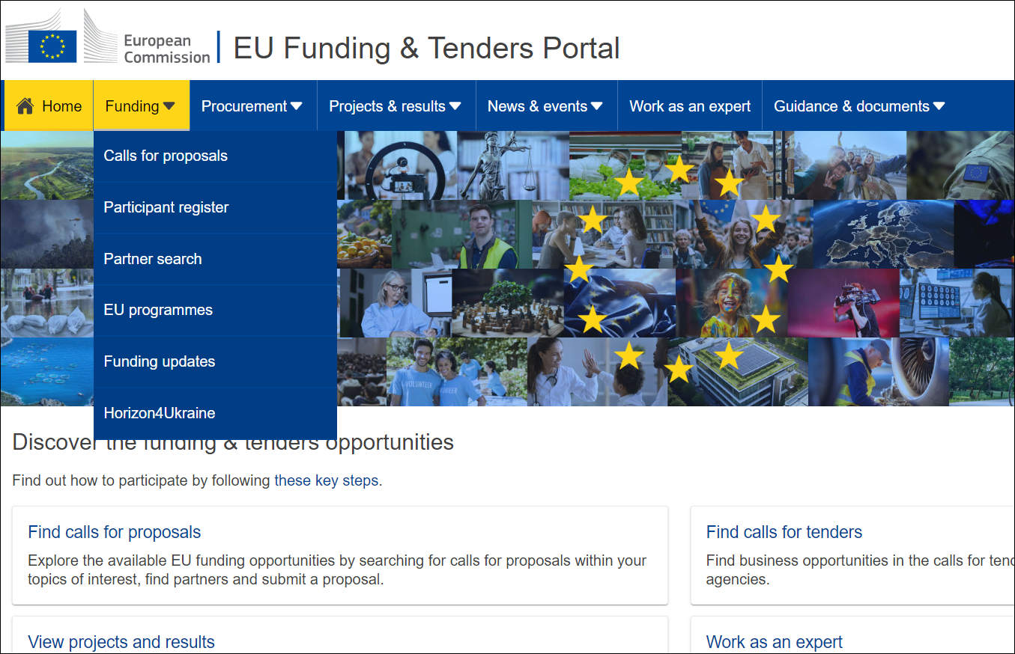
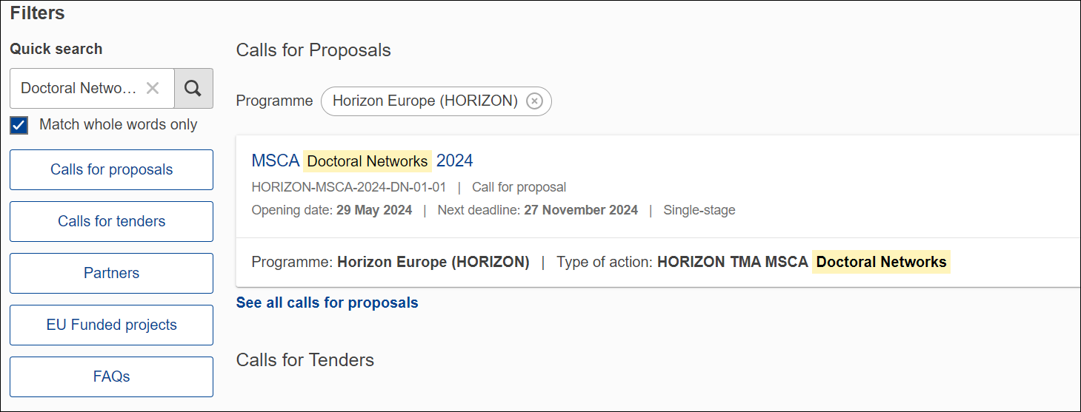
EU Funding & Tenders Portal
EU Funding & Tenders Portal

Slide 36
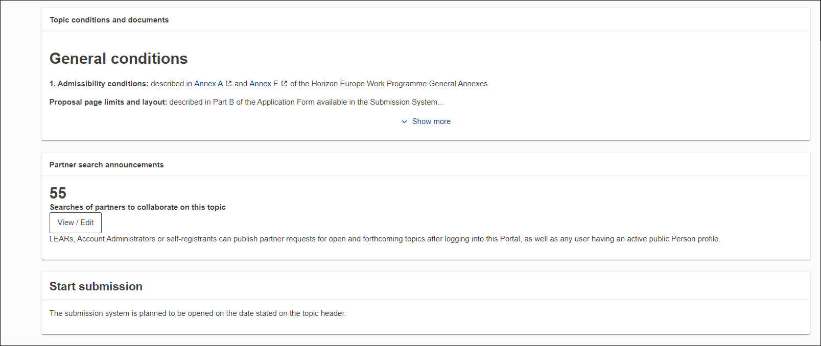
Call Page on Funding & Tenders Portal
EU Funding & Tenders Portal

Slide 37
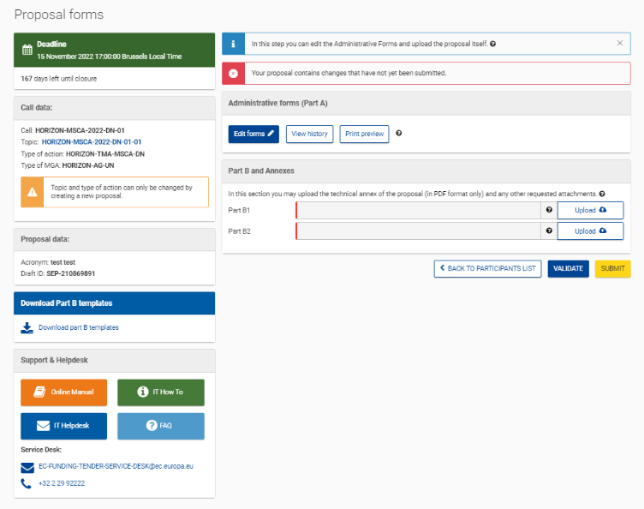
Submission system
Part A completed online
Call Information
Part B must be uploaded as a PDF
Template
Support

Slide 38
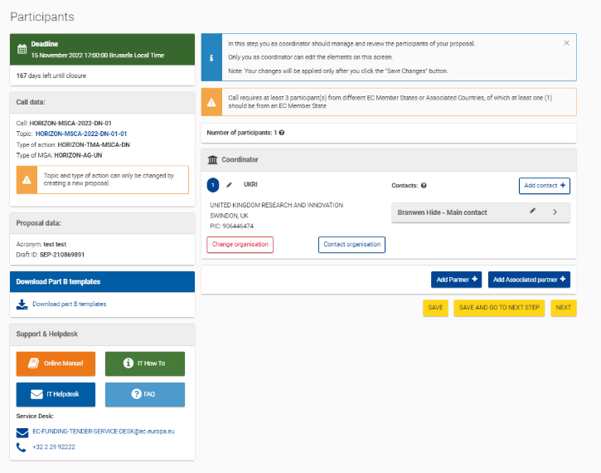
Adding Participants
Call Information
Add contact details, and partners
Template
Support
Add Partner = add Beneficiary
Add Associated Partner = add Associated Partner

Slide 39
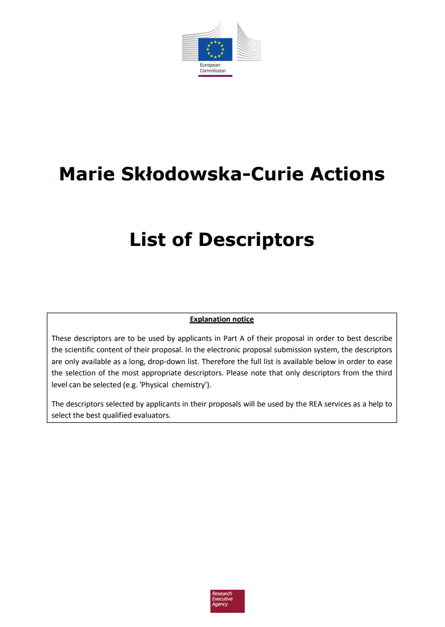
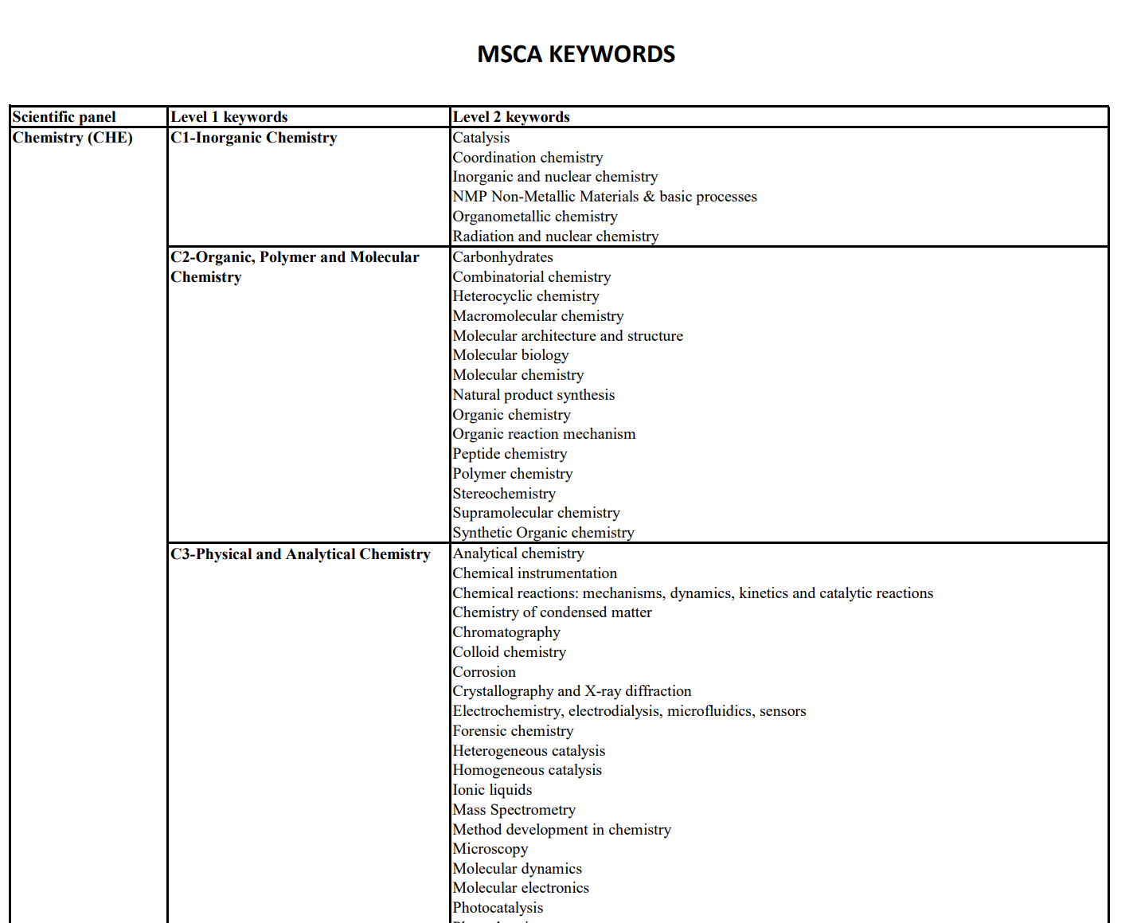
The Application
MSCA descriptors
Structured data is entered into the IT system
Acronym and title for the project (not the same)
Select the Scientific Area (i.e. panel) which is the “best fit”
Choose up to 5 “descriptors” which best characterise the content of the proposal, in descending order of relevance
First 3 descriptors should be linked to the selected panel, others unrestricted
Can add free keywords to give extra detail
Abstract: maximum 2,000 characters
Useful FAQ - EU Funding & Tenders Portal (europa.eu)
MSCA keywords

Slide 40
Panel Selection
Applicants choose one evaluation panel:
Multidisciplinary projects are still encouraged!
All DNs, inc. ID and JDs are ranked in the scientific panel of submission
No predefined budget allocation among the panels
  distributed based on no. of eligible proposals in each panel
Chemistry (CHE), Social Sciences and Humanities (SOC), Economic Sciences (ECO), Information Science and Engineering (ENG), Environment and Geosciences (ENV), Life Sciences (LIF), Mathematics (MAT), Physics (PHY)

Slide 41
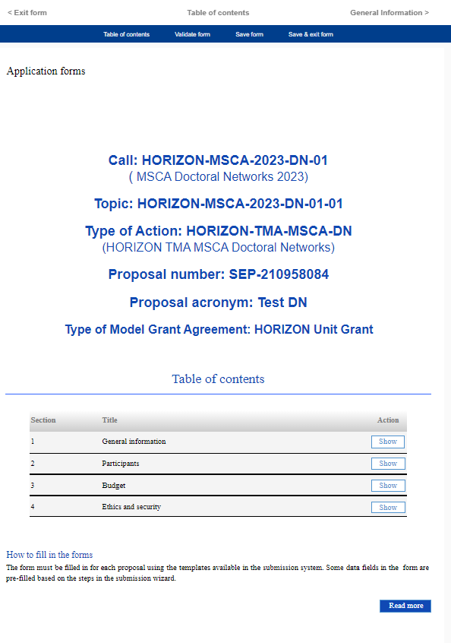
Proposal Forms – Part A (Administrative Forms)
Navigation Tool
Many fields will be pre-populated using information from both PIC and EU Log-ins.
All other fields to be completed and saved in the online form.
Sections to be completed
Guidance

Slide 42
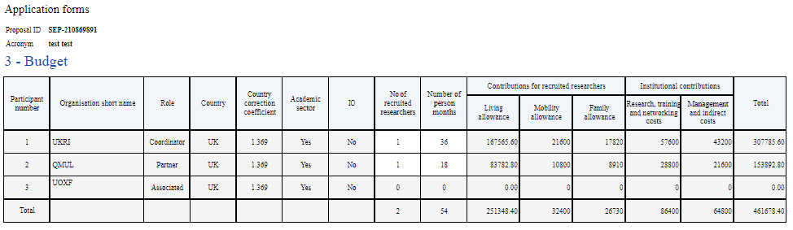
Budget Table
Partner = Beneficiary
funding based fully on unit costs, multiplied by requested person months
automatically assumes 70% of DC will be eligible for the family allowance when calculating the budget
enter the number of recruited researchers (DCs) and number of person months – taking into consideration split recruitment
cannot make changes to budget line of Associated Partner - if recruiting DC, the funding they will bring should be included in Part B

Slide 43
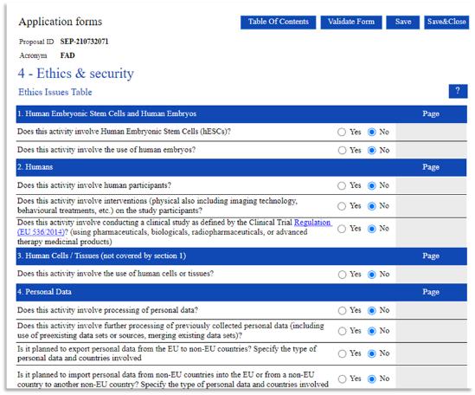
Ethics & Security questions
UK applicants should answer ‘yes’ on questions about non-European activity
follow the Horizon Europe guidance document:
‘How to complete your ethics self-assessment’
this will not affect eligibility!
answering ‘yes’ on certain questions may require a
brief text response from the applicant.
applicants may be requested to upload documents related to specific questions.
page references to relevant sections of proposal for each issue if you answer ‘Yes’ (part B1 and B2)

Slide 44
Part B
Applicants will not be able to submit their proposals unless both documents 1 and 2 are provided
Part B1 (document 1)
Comprises the Start Page, Table of Contents, List of Participating Organisations and declarations tables
Sections 1-3 (max 30 pages)
Respect the instructions!
The expert evaluators will disregard any excess pages above the 34-page limit
Part B2 (document 2)
Sections 4-7
No overall page limit is applied to this document
Respect the instructions!
Maximum total length of document is 34 pages
Complete ALL mandatory tables
Use required sub-headings
  Can also include additional subheading
Action should be divided in Work Packages (WPs)
  Should reflect the research objectives
Deliverables should be divided into:
  Scientific deliverables and management, training, recruitment and dissemination deliverables
Milestones
  Control points in the action that help to chart progress and MAY be linked to deliverables

Slide 45
Formatting
Min font size 11
Except for tables and footnotes (min. font size 8)
All margins at least 15mm**
Not including any footers or headers
Reference font is Times New Roman (Windows platform), Times/Times New Roman (Apple platforms) or Nimbus Roman No. 9 L (Linux distributions)
Literature references should be listed in footnotes
The page formatting will be systematically checked by the REA
Information provided through hyperlinks will be disregarded
Tables should not be used to circumvent min font size
Headers and page numbers as specified
Save files using specified format and naming convention
Don’t give the evaluators any reason to reject your proposal!

Slide 46
Resubmission Restriction
applicants who scored below 80% in the DN 2024 call are not eligible to resubmit a “similar” proposal in the DN 2025 call
“similar’ proposal is defined as one that differs from the current one in minor ways, and in which some of the present consortium members are involved
REA system will flag similarities with previous proposals - applicants may be contacted with request for details on difference of applications
proposals may be double-checked by external experts for most critical cases
final eligibility decision by REA Admissibility and Eligibility Committee (appointed for the call evaluation)
2025 MSCA DN Guide for Applicants (page 6)

Slide 47
Proposal Writing
Things to think about

Slide 48

Getting started
What is the over-arching research question?
  How can this be achieved through the individual PhD projects?
What are the research objectives?
  are they pertinent to the topic?
  Are they measurable, verifiable and realistic?
How does this project go beyond the current state of the art?
  What novel methods will be used?
What skills are needed by the DCs in the proposed research area?
  What and where will they be in 4 years, 10 years from now?
  Think about their long-term employability
How will the network contribute to Europe’s innovation landscape
How will the network increase doctoral training within and beyond the EU?
  Long term sustainability is important
How will the results will be exploited and communicated?
How have you considered research data management and the gender dimension?

Slide 49

Setting up your consortium
As early as possible, agree with your partners on:
  How each PhD project will fit into the overall project
  The role of each consortium partner
  What resources, supervision & training is needed
  How the budget will be allocated
  The governance, management and monitoring structure of the consortium
  The modus operandi (including project monitoring and decision making)
  Simple tables and Gantt charts can help!

Slide 50

Finding Partners
Use the MSCA matchmaking platform
Use the Partner Search function on the Call Webpage
Use your existing networks
Contact potential partners - ask yourself:
  Is my internet presence up-to-date?
  Am I clear on what I’m contributing to the project?
Check Previous Projects for potential collaborators

Slide 51
Gender/Intersectionality
Open Access
Every cell is sexed, everyone has a gender
Adds a valuable dimension to research and can take it in a new direction
Aims to eliminate gender inequalities and intersecting socio-economic inequalities
Makes research more responsive to social needs
Enhances societal relevance research and outputs
Ensures excellence and quality in outcomes and enhancing sustainability
Enhance researcher skills in Open Science and support reward systems
Open access to scientific publications as well as to data
Immediate open access via repository at the latest upon publication under open licence
All research data must be managed in line with FAIR principles, with data management plan as a standard deliverable
Open access to research data via repository under principle ‘as open as possible, as closed as necessary’
Encouraging uptake of Open Science Practices
The use of and quality of open science practices are evaluated.

Slide 52
Dissemination, Exploitation and Communication
What do you do with your results…?
Dissemination - Promoting and raising awareness of project results
Exploitation - Utilising the results (e.g., for commercial purposes or in public policymaking)
Communication - Making your research activities known to society through public engagement
Link to training & research objectives and activities
Who is the target audience and why?
Detail the activities you will use and why
One way vs. two way communication
Achievements, expectations, project activities, lessons learned,
Activities occur throughout the entire project's lifetime – not just at the end
Evaluated under ‘Impact’
Institutions often have teams that can help/support these activities

Slide 53
Expected Impact
Steps towards the achievement of the expected impacts of the project over time
Scientific impact
Creating high-quality new knowledge
Strengthen human capital in R&I
Fostering diffusion of knowledge and Open Science
Societal impact
Addressing EU policy priorities and global challenges
Delivering benefits and impacts via R&I missions
Strengthening the uptake of R&I in society
Economic impact
Generating innovation-based growth
Creating more and better jobs
Leveraging investments in R&I
begins with the results, through to dissemination, exploitation and communication
maps the contribution to the expected outcomes in the destination and wider work programme
depending on the project may address only 1 or more of the three expected impacts

Slide 54
Evaluation Process
How does it work?

Slide 55
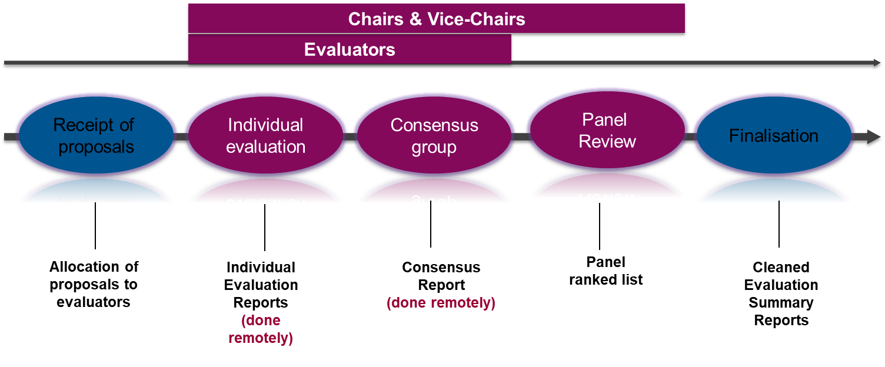
Evaluation Workflow
Automatic pre-allocation done by REA based on MSCA specific key words
Vice-Chairs revise the pre-allocation of proposals to experts
No 3 experts from the same nationality to one proposal, considering Conflict of Interest

Slide 56

Evaluation Process
1. Each of the experts prepares an Individual Evaluation Report
2. Rapporteur drafts Consensus Report (CR), reflecting their comments
3. Once comments are agreed, experts discuss and agree on a score
4. CR is reviewed by Vice-Chairs for consistency
5. Final version becomes an Evaluation Summary Report (ESR) sent to the applicant
https://ec.europa.eu/info/funding-tenders/opportunities/docs/2021-2027/horizon/temp-form/ef/ef_he-msca_en.pdf

Slide 57
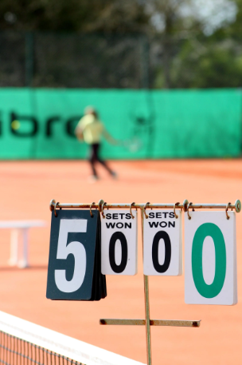
Evaluation and Scoring
Proposals are funded in ranking order
Highly competitive and typically need a score of 90-95+ depending on the panel
In case of proposals with the same score(s) → prioritisation decided by panel, based on scores for award criteria
If needed, further prioritisation based on criteria in line with the WP (e.g., gender balance of supervisors, involvement of non-academic sector, geographical spread, international co-operation, etc.)
Distribution of the indicative budget is proportional to the number of eligible proposals received in each panel

Slide 58
Evaluation Criteria
Excellence (50%) | Impact (30%) | Quality and efficiency of the implementation (20%)
Quality and pertinence of the project’s research and innovation objectives (and the extent to which they are ambitious, and go beyond the state of the art) | Contribution to structuring doctoral training at the European level and to strengthening European innovation capacity, including the potential for: a) meaningful contribution of the non-academic sector to the doctoral training, as appropriate to the implementation mode and research field b) developing sustainable elements of doctoral programmes | Quality and effectiveness of the work plan, assessment of risks and appropriateness of the effort assigned to work packages
Soundness of the proposed methodology (including interdisciplinary approaches, consideration of the gender dimension and other diversity aspects if relevant for the research project, and the quality of open science practices) | Credibility of the measures to enhance the career perspectives and employability of researchers and contribution to their skills development | Quality, capacity and role of each participant, including hosting arrangements and extent to which the consortium as a whole brings together the necessary expertise
Quality and credibility of the training programme (including transferable skills, inter/multidisciplinary, inter-sectoral and gender as well as other diversity aspects) | Suitability and quality of the measures to maximise expected outcomes and impacts, as set out in the dissemination and exploitation plan, including communication activities
Quality of the supervision (including mandatory joint supervision for industrial and joint doctorate projects) | The magnitude and importance of the project’s contribution to the expected scientific, societal and economic impacts

Slide 59
Section 1 - Excellence
Quality and pertinence of the project’s research and innovation objectives
State the research/technical problem/knowledge/specific skills gap your DN will address and how
Use diagrams, tables, figures as appropriate to clarify any point
Have clear objectives - link to methodology
Highlight originality and innovativeness
Explain how individual projects integrate into the research programme
Work Packages should reflect the research objectives
Training through research
Soundness of the proposed methodology
Describe and explain the overall methodology (links to objectives)
Explain approaches to complying with open science requirements and gender
Explain data management plans - a fully detailed DMP is not requested
If using AI, provide explanations on the technical robustness of the proposed system
Highlight inter/multi-disciplinary elements

Slide 60
Section 1 - Excellence
Quality of the supervision
Qualifications of supervisor(s) (Numbers of previously supervised fellows, of post-docs mentored etc)
Reference European Charter for Researchers
Include details of joint supervision - mandatory for Industrial and Joint doctorates;
Clear and well-structured supervisory plan
Clear role of the supervisory board
Gender balance
How will they complement each other
Who will be responsible for what aspects
Quality and credibility of the training programme
Detailed summary of the training objectives stressing the innovative aspects
Training - core research skills, advanced/additional research skills/transferable skills
Training opportunities unique and tailored to particular areas
Offered on local and network wide level or wider (as appropriate)
Emphasise the role of any non-academic organisations in the training and their impact
Including secondments is highly recommended to increase impact
Think about links to ECTS, EDCI etc - European approach to micro-credentials
What other training programmes are you apart of that the DN can take advantage of – Erasmus+. EIT, UKRI DC, COFUND

Slide 61
Section 2 - Impact
Enhancing the career perspectives and employability of researchers - contribution to their skills development
Explain the impact of the research and training on the Fellows’ careers
Link research training, transferable skill development and exposure to different sectors
Think about how the research programme fits into higher level EU policies:
European Charter for Researchers, Code of Conduct for the Recruitment of Researchers, European Code of Conduct for Research Integrity, MSCA Guidelines for Supervision
Contribution to structuring doctoral / early-stage research training at the European level and to strengthening European innovation capacity, including the potential for:
Meaningful contribution of the non-academic sector to the doctoral/research training (as appropriate)
What is their role of the non-academic sector in the programme and how does it enhance it to be world leading?
What can the programme offer that other programmes don’t or can’t?
Make sure the innovative aspects that the non-academic partners bring are emphasised
Make it clear what the sustainable elements of doctoral programmes are after the end of the DN funding

Slide 62
Section 2 - Impact
Suitability and quality of the measures to maximise expected outcomes and impacts, as set out in the dissemination and exploitation plan, including communication activities
Horizon Europe obligations to make publications and research data open access
How will the results be disseminated, which repositories, etc.?
Data Management Plan
Plans for Exploitation of results and intellectual property - detailed IP management plan is not expected
Think how, what form of protection, when?
IPR Helpdesk for MSCA Fact Sheet
The magnitude and importance of the project’s contribution to the expected scientific, societal and economic impacts (project’s pathways towards impact)
Explaining how the project’s results are expected to make a difference in terms of impact, beyond the immediate scope and duration of the project
Describe the dissemination, exploitation and communication measures that are planned, the target group
Detail the project’s plans for communication of research findings
Does the project have communication and public engagement strategy? – hint, they probably should!
Who are the appropriate audiences for these activities?
What are the appropriate means for these activities?
Communicating EU R&I Guidance for Project Participants
Scientific, Economic and Society impact (as appropriate)

Slide 63
Section 3 - Implementation
Quality and effectiveness of the work plan, assessment of risks and appropriateness of the effort assigned to work packages
Clear, concise, achievable work Packages
Research, Management, Training, Dissemination and Communication
List of major deliverables and major milestones
Quality, capacity and role of each participant, including hosting arrangements and extent to which the consortium as a whole brings together the necessary expertise
Explain the appropriateness of the infrastructure and capacity of each participating organisation against project needs
Risk assessment and mitigation
Work Packages should reflect the research objectives
Number of deliverables must be reasonable – scientific, management, training, recruitment, dissemination
Clear details on recruitment process
Contributions of participating organisations with justification – why this consortium is best to deliver
Synergies between all partners – added value of working together
How they complement and enhance each other's activities
Exposure to different sectors or working outside ‘comfort zones’:
Developing transferable skills (of benefit to industry)
Justification for funding for non-associated third countries (if applicable)
Explain the level of commitment of the organisations involved – particularly non-academic sector
Demonstrate complementarity across the network in terms of compatibility and coherence between tasks

Slide 64
Guidelines – relevant for sections 4, 5, 6 & 7
Attractive Working and Employment Conditions:
European Charter for Researchers
Code of Conduct for Recruitment
Declaration on Sustainable Researcher Careers
Guidelines for Supervision
Guidelines for Supervision
MSCA Green Charter
MSCA Green Charter | Marie Skłodowska-Curie Actions (europa.eu)
Researchers at Risk
https://ec.europa.eu/research/mariecurieactions/about-msca/guidelines-for-inclusion-of-researchers-at-risk

Slide 65

Section 4 - Network Organisation
Demonstrate tasks for each participating organisation and appropriateness
Involvement of HR or Finance support in institutions?
What do the organisations have to offer: Laboratories/Office Space, Technical expertise, Workshops, Other facilities
Refer to the European Charter for Researchers and institutional endorsement
‘HR Strategy for Research (HRS4R)’ award - demonstrates competence for recruiting and hosting
Explain who will be responsible for what and when will they do it:
  Network organisation and management structure/supervisory board
  Admission, selection, supervision, monitoring and assessment procedures
  Risk management at consortium level
  IPR, Gender, Open Access, Data Management etc.
Clear decision making and conflict resolution strategies
Clear progress monitoring provisions
Does the organisation have other HR awards? E.g., Athena Swan?

Slide 66


Section 5: Environmental aspects in light of the MSCA Green Charter
MSCA Green Charter is a set of guiding principles that aim to raise awareness, encourage best practice, empower fellows
How will the project reduce its the carbon footprint?
How will the project increase the awareness on environmental issues, promote sustainable behaviours and policies?
  Of the recruited researchers and organizations involved
What do the institutions already do that will be capitalized on the project?
How will the project adhere to the MSCA Green Charter during implementation
Directly link to research and training
MSCA Green Charter Guidance Material

Slide 67
Key Considerations for Sections 6 and 7
Operational capacity of the organisations
Use tables to present factual information
Profile of key staff, description of key infrastructure or technical equipment,
Partner organisations contributing towards the proposed work
Different information for Beneficiary and Partner
If requested in Part A – be consistent
Letters of Pre-Agreement
For DN / JD
Signed by an authorised legal representative
Offer reasonable assurance regarding the commitment to award the joint, double or multiple doctoral degree(s)
Basic template provided
Included in part B2
Lack of a letter can deem proposal ineligible

Slide 68
Evaluator Comments – Excellence
Strengths
the overview of the action as well as the objectives are clearly formulated and well-balanced between scientific and training and mobility.
The research programme is clearly articulated, coherent and relevant regarding the field.
The individual research projects are sufficiently analysed and in line with the research objectives.
Qualifications and supervision experience of the supervisors are well evident.
All participants have established strong synergies in the field.
The partners interact in actively.
Weaknesses
Innovative aspects of the training are not clearly justified.
The interaction between academic and non-academic partners is not fully explored.
Gender aspects of the research approach are not convincingly demonstrated. The information provided regarding gender issues does not refer to clear provisions translated into concrete measures.
The allotted time for some of the activities, e.g. the conference, is not sufficiently considered.
The opportunities to pursue research careers at high profile universities and in well-established private enterprises are not sufficiently elaborated.
The roles of the non-academic partners are well-integrated.

Slide 69
Evaluator Comments – Impact
Strengths
The potential for meaningful contribution of the non-academic sector is high and credible.
The dissemination strategy is concrete and appropriate and offers a practical plan on how to share data resources and results of the project with different target groups like partners, specialists and a general audience.
The communication and public engagement strategy are clearly described, using different platforms and taking advantage of special events like the European Researcher’s Night, which ensure a broad audience.
The communication plans include a good number of actions towards the industrial sector.
Relevant outcomes for the economy and society are adequately outlined.
Long-lasting collaboration between sectors after the end of the project are foreseen.
Weaknesses
The impact of the programme on the fellows’ careers beyond the research field is not guaranteed.
The relevance of complementary skills to enhance careers of the fellows is insufficiently discussed.
The measures for dissemination of results have been described; however the dissemination plans are not quantified and no innovative activities are included. The focus on disseminating results within the small membrane scientific community is not clearly justified.
Outreach activities towards general public described, but relevance is not clearly discussed.

Slide 70
Evaluator Comments – Implementation
Strengths
The listed work packages are well defined with clear deliverables and milestones.
The individual ESR projects are well structured with well-argued and realistic objectives, expected results, secondments. The secondments are coherent with the objectives.
The basic principles of the management of the project are clearly formulated: shared responsibility, joint ownership of data and good communication.
The management structure is clear and well-structured with a Supervisory Board that guarantee an adequate balance between scientific and technological training.
The management plan offers a realistic problem-solving mechanism in the event of disputes between partners with the creation of an External Advisory Committee.
The progress monitoring mechanisms and evaluation of individual projects are clearly presented.
Weaknesses
The procedure for awarding doctoral degrees is not clearly presented.
The complementarity of the partners is not sufficiently demonstrated.
Key research facilities, infrastructure and equipment of both beneficiaries are insufficiently detailed
The timing in the work plan is not convincing
The management structure is not fully clear. It contains few bodies and relies to a large extent on individuals instead of boards/committees. The structure supporting this is not clearly explained.
The scientific milestones and their means of verification are not sufficiently defined.

Slide 71

Additional Resources
- UKRO Portal
- MSCA: How to Apply
- MSCA Work Programme 2023-2025
- MSCA Finacial Guide
- MSCA-NET 2024 handbook and policy briefs
- MSCA-NET RADIANCE FAQ
- Funding & Tender Opportunities Portal
- Horizon Europe Strategic Plan 2025-27
- Horizon Europe Programme Guide
- Open Science Resources OpenScience.eu, Open Science, How to evaluate open science in Horizon Europe Proposals
- Gender in Research Resources Genderaction.eu ,Gendered Innovations ,Gender in Research

Slide 72
Thank you!
mariecurie-uk@ukro.ac.uk
10 July 2025

